Slide 1

Environmental disaster monitoring in HSR-IoT
Sohon Kumar Das (A91404819011)
BCA “A”
6th Sem
Dr. Abhijit Paul

Slide 2
Disaster Management
Disasters take many shapes. Human-made disasters result from human errors and include industrial explosions or structure failures.
Natural disasters result from physical phenomena and include earthquakes and droughts.
Disasters classified as complex can include epidemics or armed conflicts.
In whatever form, disasters disrupt communities and can take a serious toll on people, property, economies, and the environment.
They often stretch a community’s capacity to cope.

Slide 3
Disaster Management
Disaster management is a process of effectively preparing for and responding to disasters.
It involves strategically organizing resources to lessen the harm that disasters cause.
It also involves a systematic approach to managing the responsibilities of disaster prevention, preparedness, response, and recovery.

Slide 4
Introduction
The high-speed railway ( HSR ) has emerged as the primary mode of transportation for the development of the world's transportation industry, ushering humanity into a new era as a safe, dependable, fast, comfortable, large carrying capacity, low-carbon, and environmentally friendly mode of transportation.
Natural disasters such as gales, rainstorms, heavy snow, earthquakes, geology disasters, thunder, and lightning have a low probability but cause considerable damage in the safe functioning of HSR. HSR's early warning system for natural disasters requires extensive research to ensure its social and economic viability.

Slide 5
Role of IoT in HSR
The HSR IoT is designed to boost industrial efficiency while reducing labour intensity and ensuring operational safety. The following are the functions of HSR IoT:
Transportation safety that is digitalized
Interconnected Networks
Services for intelligent operations

Slide 6
Comprehensive Natural Disaster Monitoring System for Safe Operation of HSR
A comprehensive natural disaster monitoring system for safe HSR operation should be built to prevent possible natural catastrophes (such as wind, rain, lightning, temperature, debris flow, earthquake, and others) from affecting the normal operation of the HSR.
Wind, rain, lightning, temperature, geological disasters, earthquakes, and other natural calamities all have early warning systems.
On-site monitoring sites along, an early warning unit, an early warning centre, and the related system interface make up HSR's natural disaster early warning system.
It provides real-time monitoring, alarm, and early warning features for natural disasters and emergencies on the HSR, allowing for emergency disaster disposal and catastrophe minimization to avoid subsequent disasters.

Slide 7
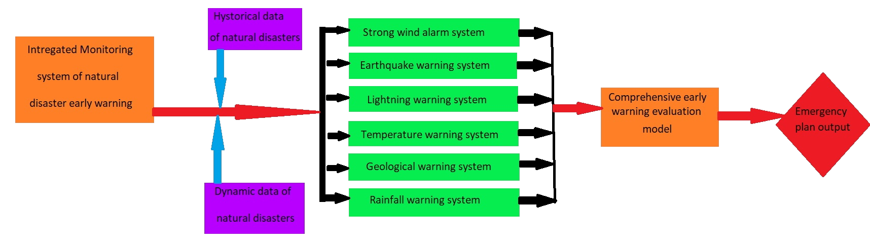
Monitoring System

Slide 8
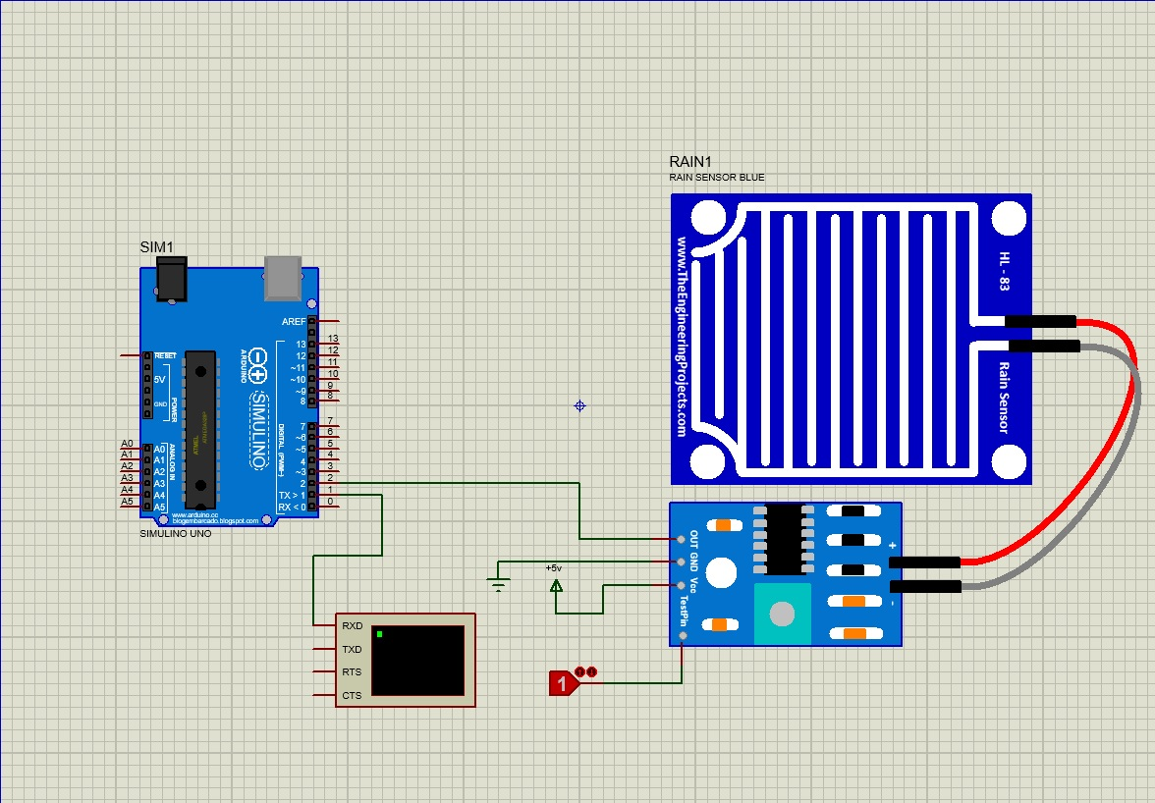
Disaster Management System for Rainfall

Slide 9
Tools Used:-
Simulino Uno
Rain Sensor
Logicstate
Power
Ground
Virtual Terminal

Slide 10
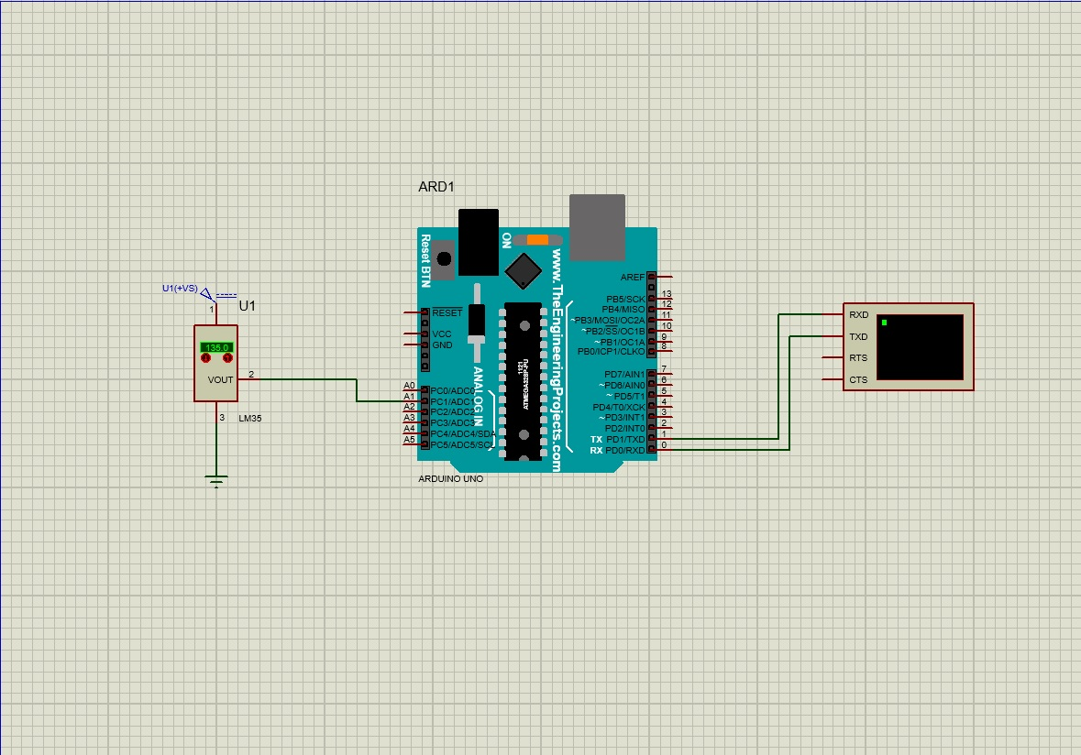
Disaster Management System for Temperature

Slide 11
Tools Used:-
Arduino Uno R3
LM35
Ground
Virtual Terminal

Slide 12
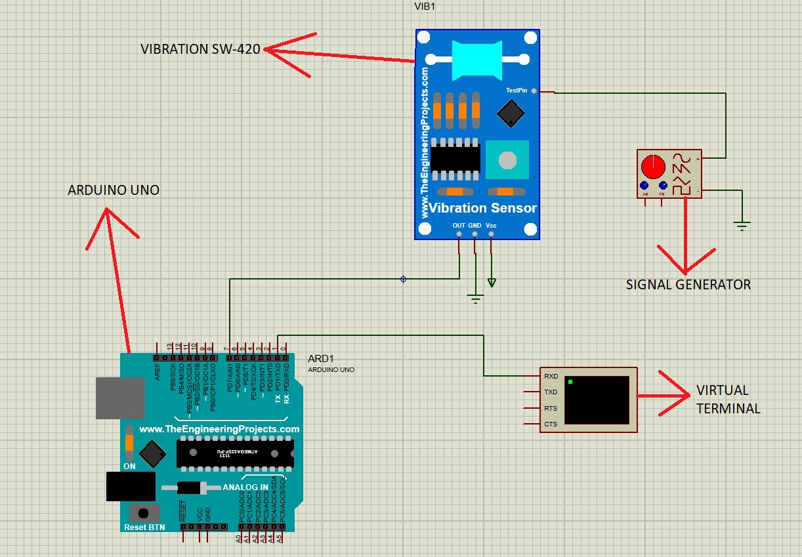
Disaster Management System for Earthquake

Slide 13
Tools Used:-
Arduino Uno R3
Vibration SW 420
Power
Ground
Signal Generator
Virtual RS 232

Slide 14
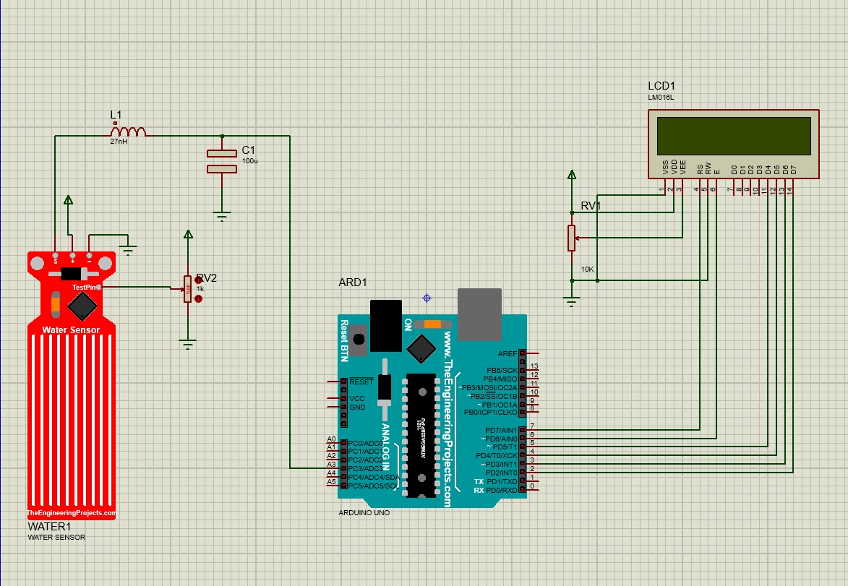
Disaster Management System for Flood

Slide 15
Tools Used:-
3214G-1-103E
Arduino Uno R3
Capacitor
Inductor
LM016L
Pot-HG
Water Sensor
Power
Ground

Slide 16
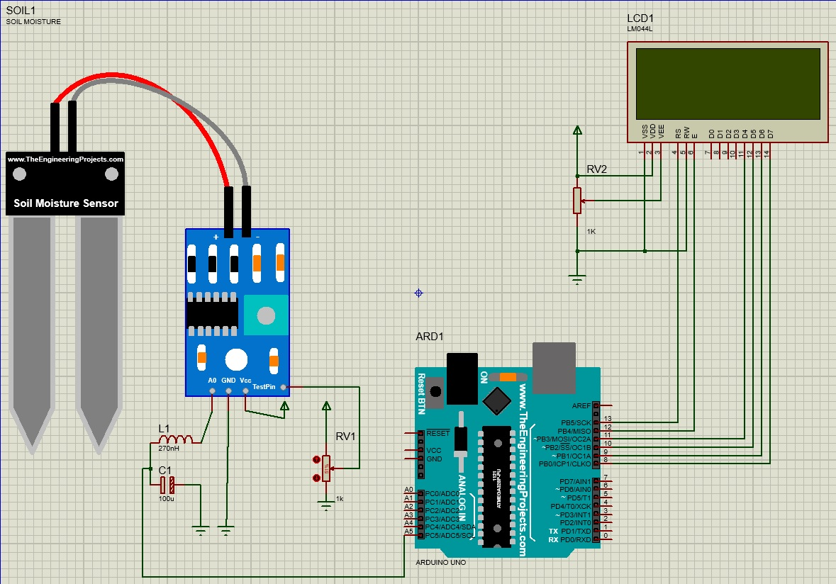
Disaster Management System for Landslide

Slide 17
Tools Used:-
Arduino Uno R3
Soil Moisture Sensor
LM044L
1210-271K
3005P-1-102
A700V107M002ATE028
Pot-HG
Power
Ground

Slide 18
Conclusion
Wrapping up the presentation, I conclude that those are some of the fundamental disaster signal providers; nonetheless, I'd like to learn more about other disasters for disaster management. Because my project is about disaster management in the HSR-IoT, I limited my research to a few basic disasters.
For my future scope, I'll find more about other disasters.

